Slide 1

Climate Policy Assessment Tool
(CPAT)
Workshop

Slide 2
Roadmap for Workshop
Overview of CPAT
Methodology of CPAT
Egypt-Specific Exercise
& Q&A
How to Use CPAT

Slide 3
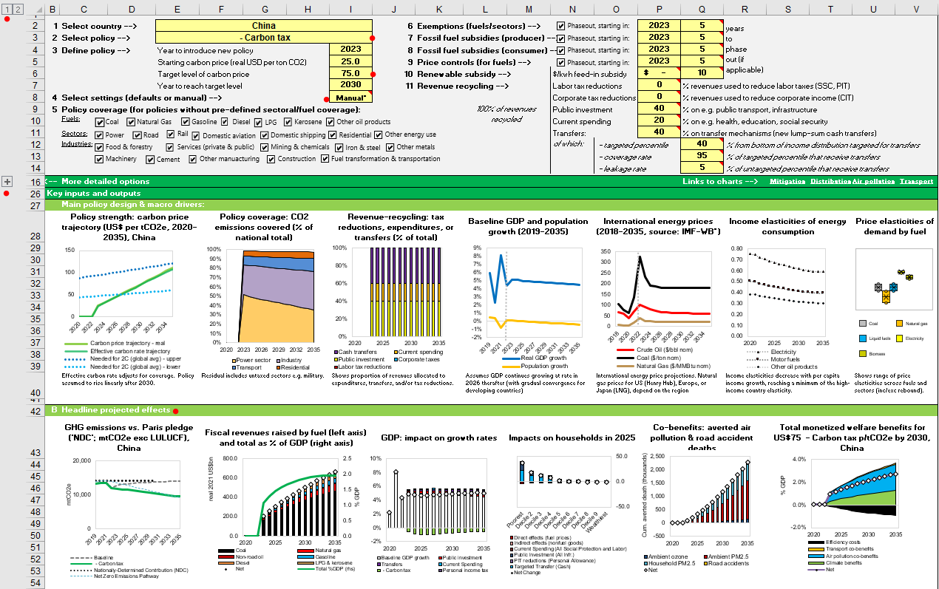
OVERVIEW OF CPAT

Slide 4
Overview of CPAT
CPAT Overview
Impacts Modelled
Country Coverage
Policies Covered
Why Use CPAT
Dashboard Layout
Summary
4

Slide 5

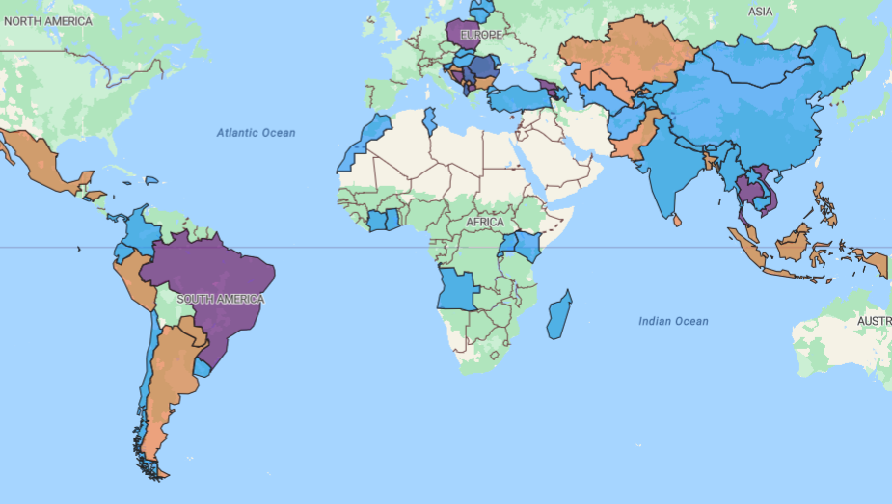

CPAT Overview
To request CPAT, email: cpat@worldbank.org
CPAT is a spreadsheet-based tool for 190 countries:
Developed jointly by IMF & WB for govt. use.
Evaluate policies for climate, fiscal, devt. goals.
Methodology: Price/GDP elasticities, power sector model, GDP multipliers; distributional & air pollution modules
CPAT Key Benefits:
Quick, Flexible
High Country Availability
Many Impact Metrics (co-benefits)
IMF-WB Joint Tool
Existing studies in 72 countries:
Rapid impact assessment:
Energy & emissions
Macro and fiscal
Distributional effects
Co-benefits (e.g., air pollution, transport)
Used in reports such as:
CCDRs
PFRs
PMI TA (e.g., Azerbaijan)
Also, ad hoc requests
  CPAT can evolve with client demand
  CPAT does not replace other (e.g., macro / technoeconomic) models.
Recent PMI CPAT Study in Azerbaijan (2025)

Slide 6
Impacts Modelled in CPAT
Energy & emissions
Revenue and GDP impacts
Distributional impacts
Development co-benefits (Health)
Rapid estimation of multiple effects of carbon pricing
6
Notes:
A spread-sheet tool spanning 175 countries that allows for rapid estimation of the effects of climate mitigation
Env. Tax Reforms include carbon pricing policies and subsidy phase out
Energy and emissions: prices, consumption, global pollutants (GHGs), local pollutants (PM2.5, NOx, etc)
Macroeconomic impacts: GDP, revenues, trade balance
Distributional impacts: effects of policies including revenue recycling across on households (across income distribution and urban vs. rural) and firms (requires household expenditure survey)
Development co-benefits: reductions in mortality & morbidity from improved in air quality and road safety, reduced congestion
Aimed at economists in the WB, IMF, finance ministries, planning and line ministries
Designed to be accessible to policy makers when comparing impacts and design of policies to achieve mitigation targets

Slide 7
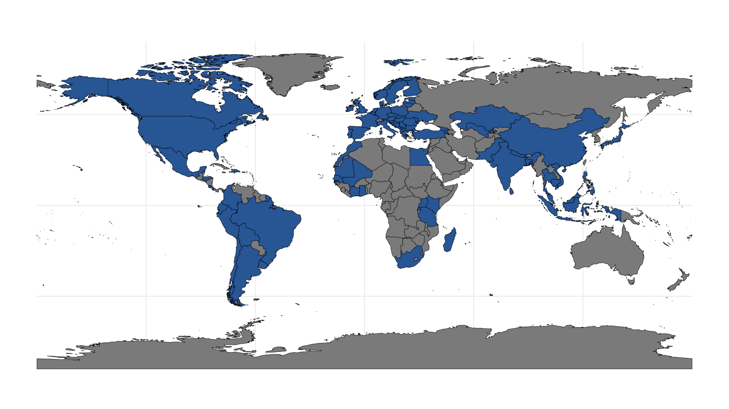
Country Coverage
Covers around 190 countries
Projects Completed in 72+ countries
Distributional Data in 74+ countries

Slide 8
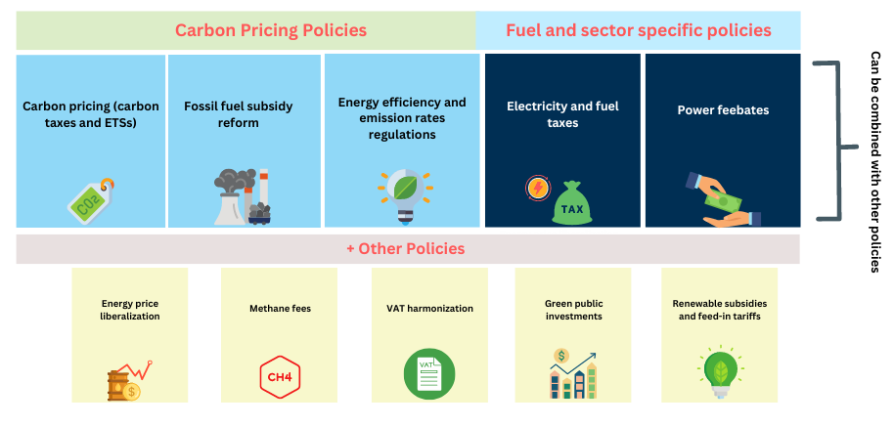
CPAT Policies
(Work in progress)
8

Slide 9
Why Use CPAT?
Rapid estimation of multiple effects of carbon pricing
Help design, compare, and implement different policies
CPAT Documentation
More methodological and technical details are available in the CPAT documentation.
9
Notes:
A spread-sheet tool spanning 175 countries that allows for rapid estimation of the effects of climate mitigation
Env. Tax Reforms include carbon pricing policies and subsidy phase out
Energy and emissions: prices, consumption, global pollutants (GHGs), local pollutants (PM2.5, NOx, etc)
Macroeconomic impacts: GDP, revenues, trade balance
Distributional impacts: effects of policies including revenue recycling across on households (across income distribution and urban vs. rural) and firms (requires household expenditure survey)
Development co-benefits: reductions in mortality & morbidity from improved in air quality and road safety, reduced congestion
Aimed at economists in the WB, IMF, finance ministries, planning and line ministries
Designed to be accessible to policy makers when comparing impacts and design of policies to achieve mitigation targets

Slide 10
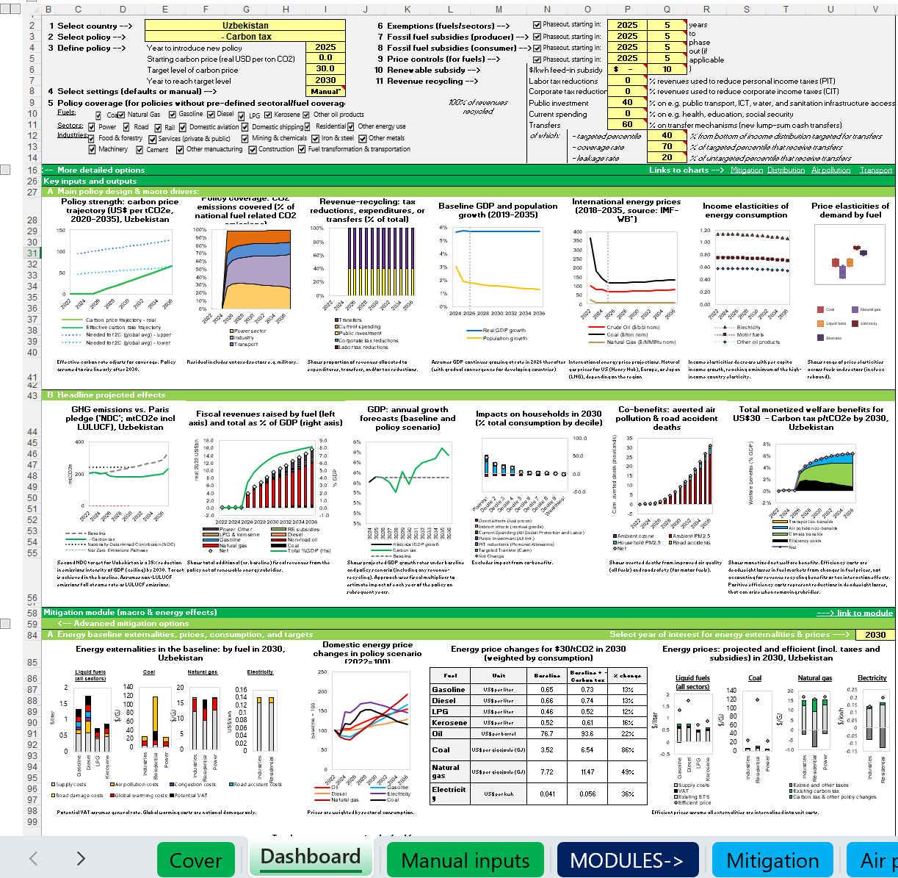
CPAT Dashboard
Policy design
Policy Strength, Assumptions
Core Outputs
Prices
Navigation

Slide 11

CPAT Dashboard
Policy design
Policy Strength, Assumptions
Core Outputs
Settings (Expandable)
Prices
Navigation

Slide 12
Summary of Main Uses Of CPAT
Policy Simulation for Environmental Taxation and Subsidy Reform
  Energy, Emissions, Revenues, GDP Impacts
  Distributional Impacts and Co-benefits of Reform (Health from Air Pollution, Congestion)
Dashboard of Current Emissions and Energy Use and Projections Forward

Slide 13
Summary of CPAT
About the Climate Policy Assessment Tool (CPAT)
CPAT Key Benefits:
CPAT is a spreadsheet-based tool for 190 countries:
• Developed jointly by IMF & WB for internal and govt. use.
• Evaluate policies to meet climate, fiscal, devt. goals.
• Methodology: Price/GDP elasticities, power sector model, GDP multipliers; distributional & air pol. modules
• Quick, Flexible: CPAT can evolve with client demand
• High Country Availability
• Many Impact Metrics (co-benefits)
Used in reports such as:
• IMF-WB Joint Tool
• Existing studies in 72 countries
• Country Climate Development Reports (CCDRs)
CPAT Scope & Caveats:
Rapid impact assessment:
• Public Finance Reviews
• Policy focus: carbon pricing instruments
• Energy & emissions
• Technical Assistance
• Offsets not covered
• Macro and fiscal
• Also, ad hoc requests
• Relatively simple approach to energy, emissions and GDP
• Distributional effects
• Co-benefits (e.g., air pol.)
• Medium-term tool (next 15 years); does not replace macro/technoeconomic models

Slide 14
CPAT METHODOLOGY

Slide 15
Methodology
Overview
Mitigation (Energy Use, Revenues, Emissions)
Distribution
Air Pollution
Transport and GDP
15

Slide 16
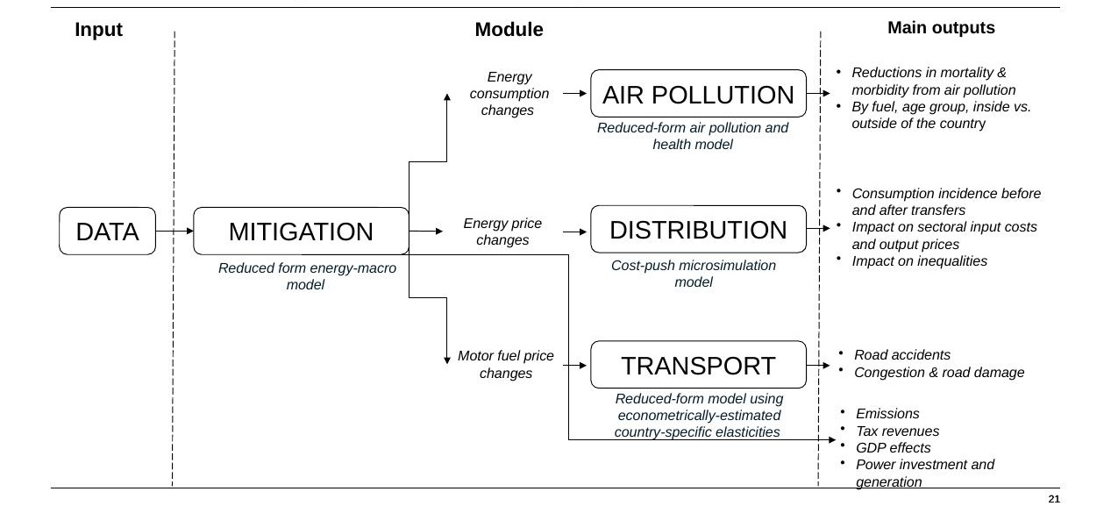
CPAT Structure — Model of Models Overview

Slide 17
Overview Of Modules
Simple Version
DASHBOARD
Policy Inputs,
Settings
DASHBOARD
Output Graphs
MITIGATION
Prices,
Energy Use,
Emissions,
Revenue,
GDP
DISTRIBUTION
AIR POLLUTION
TRANSPORT

Slide 18
Overview Of Modules
With Data Flows
DASHBOARD
Policy Inputs,
Settings
Policies and Settings
DASHBOARD
Output Graphs
MITIGATION
Prices,
Energy Use,
Emissions,
Revenue,
GDP
Prices, Energy Use, Emissions, Revenue, GDP
Energy price changes
DISTRIBUTION
GHG and Local Pollutants
AIR POLLUTION
Motor fuel price changes
TRANSPORT

Slide 19
Overview Of Modules
With Systematic Inputs and Outputs
DASHBOARD
Policy Inputs,
Settings
Policies and Settings
DASHBOARD
Output Graphs
MITIGATION
Prices,
Energy Use,
Emissions,
Revenue,
GDP
Prices, Energy Use, Emissions, Revenue, GDP
Energy price changes
DISTRIBUTION
GHG and Local Pollutants
AIR POLLUTION
Motor fuel price changes
TRANSPORT
MTInputs
Scenario Settings
MTOutputs
Output Data
Includes all policy & settings for future reproducibility
Interacts with Multiscenario Tool (advanced use)
Includes all data outputs
Interacts with Multiscenario Tool (advanced use)

Slide 20
Climate Policy Assessment Tool (CPAT)
CPAT • How to Use • Backup / Advanced
Methodology
Five linked modules: Mitigation, Distribution, Air Pollution, Transport, and revenue/GDP.
A baseline (no policy) is compared with a policy scenario chosen by the user.
Results run year by year, typically to 2030 or 2050.
What is CPAT?
An Excel-based tool that estimates the effects of carbon pricing and energy-price reform for a country.
Who builds and maintains it?
A joint World Bank – IMF team, with partners. It is updated regularly.
What does it produce?
Effects on prices, energy use, emissions, revenues, GDP, household welfare and health.
Settings & dashboard
Choose country, policy type, and start year on the dashboard.
Set the carbon price path and how revenue is used.
Data sources
IMF • World Bank • IEA • UNFCCC • country statistics

Slide 21
Methodology
Overview
Mitigation (Energy Use, Revenues, Emissions)
Distribution
Air Pollution
Transport and GDP
21

Slide 22
Mitigation: How One Effect Leads to the Next
Mitigation Module • Overview • Module 1
CPAT follows a chain. A carbon price changes energy prices. New prices change how much energy people use. Energy use sets emissions, revenues, and effects on GDP.
Carbon Price
→
Energy Prices
→
Energy Use
→
Emissions
→
Revenues & GDP
Two ways to model the power sector
Engineer model (default): builds the capacity of each power type to meet demand.
Elasticity model: uses price changes and elasticities to set each type's share.

Slide 23
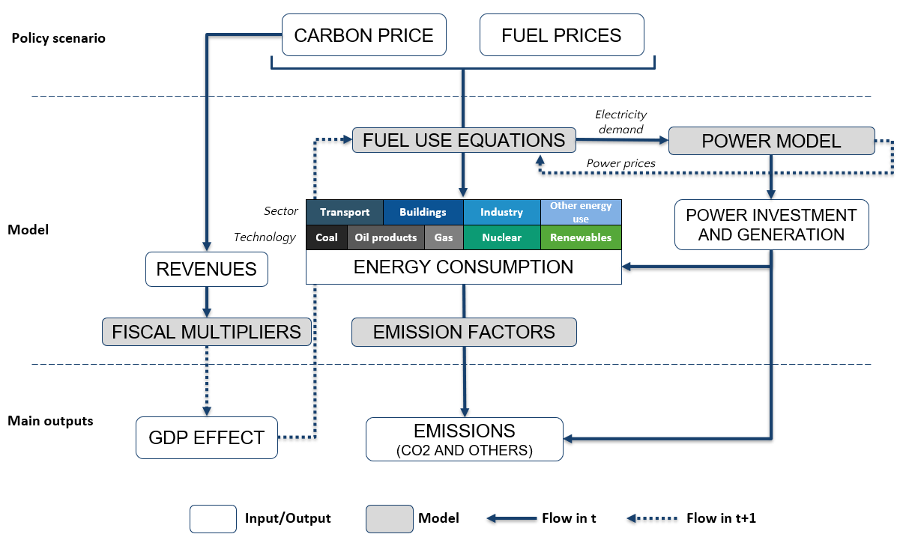
Mitigation Module: Energy Consumption Part

Slide 24
Energy Sectors and Price Coverage
Non-fuel prices
Oth. Ren
Hydro
Nuclear
Wind
Solar
Fuel prices
Jet fuel
Gasoline
Diesel
LPG
Coal
Coal
Coal
Natural gas
Nat. gas
Nat. gas
Electricity
Electricity
Oil products*
Biomass*
Kerosene*
Sectors
Transport
Industry
Residential
Power
CPAT subsectors
Power sector
Food & Forestry
Services (public & private)
Food & forestry
Non-ferrous metals
Residential
Machinery
Cement
Other manufacturing
Services (public & private)
Construction
Mining and chemicals
Domestic navigation
Iron and steel
Fuel transformation and transportation
Rail
Domestic aviation
Road
24

Slide 25




Mitigation Module: Main Fuel Use Equation
$$F_{t} =F_{t−1}{\left(\frac{Y_{t}}{Y_{t−1}}\right)}^{ε_{Y}} ∙ {\left(\frac{1}{\left(1+α\right)}\right)}^{1+ε_{U}}∙{\left(\frac{p_{t}}{p_{t−1}}\right)}^{ε_{F}+ε_{U}{+ε}_{F}ε_{U}}$$
Sectoral demand for energy E for year t
=
Previous year’s demand
Price effect
own price elasticity, endogenous efficiency, and rebound (increased efficiency increases energy demand)
x
Growth effect
x
Exogenous technical change effect
(less rebound)
x
α
= exogenous energy efficiency improvements
$$ε_{Y}$$
= constant income elasticity of demand for energy-using product
$$ε_{U}$$
= constant price elasticity of demand for energy-consuming products wrt. unit energy costs
$$ε_{F}$$
= elasticity of consumption rate (inverse of energy efficiency)
For more details, please refer to the CPAT documentation

Slide 26
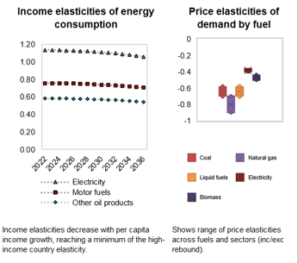
GDP and Price Elasticities
We project energy forward using population growth and per-capita GDP growth and GDP elasticities of energy use
GDP elasticities are somewhat dependent on GDP level, so country specific in that sense
We project the impact of prices (including policies) on energy consumption based on specific price elasticities of energy use
Elasticities can also be modified manually

Slide 27
Power Sector Model
Power demand model
Retirement model
Investment model
Dispatch model
Based on income and price elasticity of power demand
Includes cost-based coal ‘early retirement’ options
Models renewables/nuclear
as always run and then
considers the trade off
between coal and gas
in relation to price
Models the addition of new capacity

Slide 28
CPAT Mitigation: Data Sources
CPAT module | Topic | CPAT data tabs | Data category |  | Data source
Mitigation | Greenhouse Gas Emissions | GHGs | Open |  | IMF, EDGAR, UNFCCC, FAO
Mitigation | Nationally Determined Commitments | NDCs | Open |  | Climate Watch
Mitigation | Domestic Fuel Prices | Prices | Derivatives from proprietary data |  | Various: IEA, Enerdata country offices, OECD. Refined.
Mitigation | Elasticities & Annual Efficiency Improvements | Elasticities | Open |  | Various (literature review)
Mitigation | Existing Carbon Prices | ECPPC | Open |  | WB Carbon Pricing Dashboard
Mitigation | Power Sector Data | Power | Derivatives from open data |  | CPAT calculations
Mitigation | Social Cost of Carbon | SCC | Open |  | Ricke, K., L. Drouet, K. Caldeira and M. Tavoni. "Country-level social cost of carbon" (2018)
Mitigation | Energy Consumption | EnergyConsumption | Open |  | CPAT derivative/forecast from multiple sources
Mitigation | World Development Indicators | WDI | Open |  | World Development Indicators
Mitigation | Macro data and projections from World Economic Outlook | WEO2020 | Open |  | IMF WEO
Mitigation | Macro Balance of Payments from World Economic Outlook | WEOBOP | Open |  | IMF WEO
Mitigation | Emissions Factors | EF_GHG | Open |  | IIASA's GAINS model
Mitigation | International Energy Price Forecasts | Energy_intprice | Open |  | World Bank Commodity Price Forecasts, IMF World Economic Outlook, IEA World Energy Outlook
Mitigation | Population | Popn | Open |  | Global Burden of Disease (2020); Vollset et al (2020)
Mitigation | Multipliers | Multipliers | Open |  | CPAT team

Slide 29
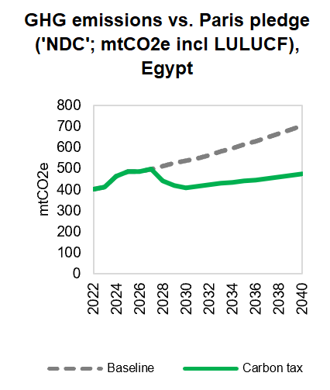
Modelled Results: Emissions Reductions
Code | Policy bundle | Emissions coverage (% of total GHG) | Estimated total emissions reductions (MtCO2)
 | Policy Bundle Options - Carbon Pricing (modelled)
1A | Comprehensive carbon levy: upstream carbon price on all fossil fuel consumption + downstream emissions in CBAM sectors only + recycling to public investment | 59% | -41.6
2A | Carbon levy on all fossil fuel consumption (upstream carbon price) + recycling to public investment | 53% | -38.9
2B | Carbon levy on all fossil fuel consumption (upstream carbon price) + recycling to households | 53% | -41.0
3A | Downstream carbon price on heavy industry + recycling to households | 11% | -21.5
3B | Downstream carbon price on heavy industry + output-based rebating (OBR) for CBAM producers | 11% | -9.6

Slide 30
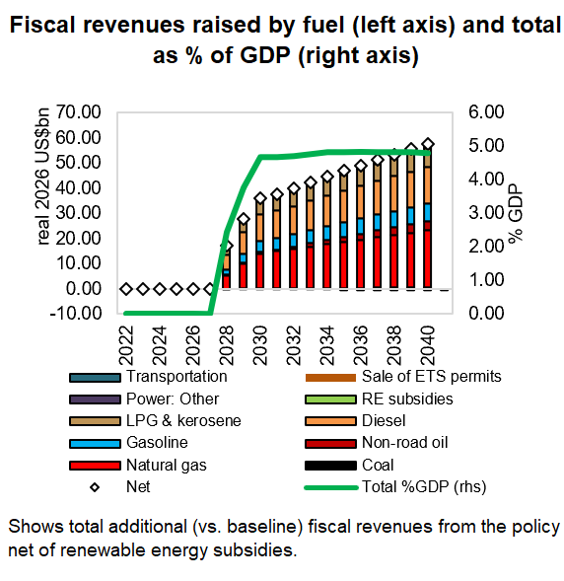
Modelled Results: Revenue Results
Code | Policy Bundle | Revenue recycling option | Carbon revenues raised ($bn)
 | Policy Bundle Options - Carbon Pricing (modelled)
1A | Comprehensive carbon levy: upstream carbon price on all fossil fuel consumption + downstream emissions in CBAM sectors only + recycling to public investment | Public investment | 5.8
2A | Carbon levy on all fossil fuel consumption (upstream carbon price) + recycling to public investment | Public investment | 5.2
2B | Carbon levy on all fossil fuel consumption (upstream carbon price) + recycling to households | Households | 5.2
3A | Downstream carbon price on heavy industry + recycling to households | Households | 1.1
3B | Downstream carbon price on heavy industry + output-based rebating (OBR) for CBAM producers | Firms (output) | 0.0

Slide 31
Methodology
Overview
Mitigation (Energy Use, Revenues, Emissions)
Distribution
Air Pollution
Transport and GDP
31

Slide 32
Net Effect on Family Budgets
Distribution Module • Method & Result
The Mitigation Module shows effects on the whole economy. The Distribution Module zooms in: how does the policy change the budget of rich and poor families? For each income group, CPAT adds up the cost of the policy and subtracts any money returned. The result is the net change in what a family can consume.
Net effect = money returned − higher energy bills − higher prices of other goods
Before revenue use
The raw cost falls across the spectrum equally, with middle income people more affected
After revenue use
Returning even half the revenue to the bottom 40% can leave poor families better off. The policy becomes equity-enhancing.
Energy bills
Electricity, gas, and fuel cost more.
Other goods
Food, clothing and more cost more (costlier inputs).
Revenue use
Cash transfers or spending can give money back.
Main data source: national Household Budget Surveys, processed by the CPAT team. Coverage: 84+ countries across all income and regional groups.

Slide 33
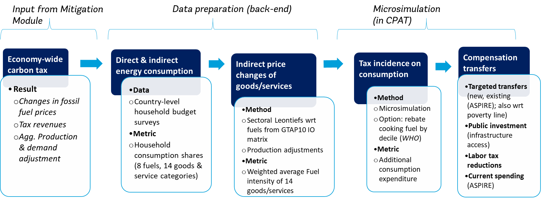
Modelling Process
CPAT Distribution Module: Methods
Further information available in the Distribution Module Reserve Slides.

Slide 34
CPAT Dashboard
Policy design
Policy Strength, Assumptions
Core Outputs
Prices
Navigation

Slide 35
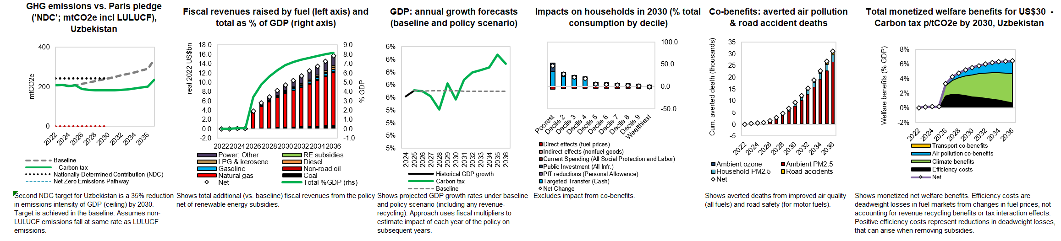
Output Graphs
  Session 2
  Emissions
  Fiscal Revenues
  GDP
  Session 3
  Impacts on Households
  Co-benefits (avoided deaths)
  Total $ welfare effects

Slide 36
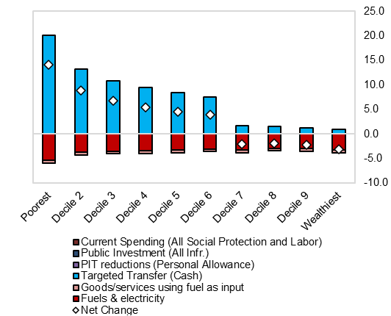
Let’s look at an example
CPAT Distribution Module: Sample Results
Initial household consumption losses higher (lower) for poorer (richer) families (“regressive”) and mostly due to higher energy bills
Using even half the revenues to compensate bottom 60% of income distribution can lead to net consumption gains for poor
Carbon taxes can be designed as equity-enhancing policies
Figure 1. Uzbekistan: Relative mean consumption effect (Percent Consumption Losses (-)/Gains (+))
from US$ 25/ton CO2e Carbon Tax, 2030
World Bank staff estimates based on CPAT and the 2019 national Household Budget Survey (HBS).

Slide 37
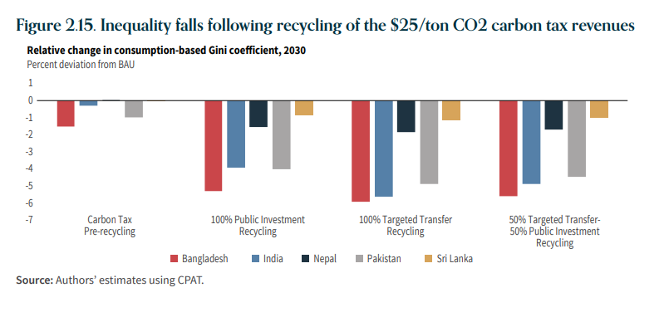
Carbon Tax makes inequality better (and more so including revenue use)
CPAT Distribution Module: Sample Results
Source: Spring 2022 South Asia Economic Focus (SAEF).

Slide 38
Who Pays? Effects on Households
Distribution Module • Overview • Backup / Advanced
Q & A
Q. Direct vs indirect effects?
A. Direct = energy bills. Indirect = costlier goods made with costlier energy.
Q. How many countries are covered?
A. 84+ countries, across all income and regional groups, and growing.
Q. What data is used?
National Household Budget Surveys, processed by the CPAT team.
Q. What does 'regressive' mean here?
A. The raw cost takes a bigger share of income from poorer families.
Q. How can the policy become progressive?
A. By returning revenue — even half to the bottom 60% can make poor families better off.
Q. Is the result the same everywhere?
A. No. It depends on each country's spending patterns and revenue use.
Methodology
Net effect = money returned − higher energy bills − higher prices of other goods.
Computed for each income group, before and after revenue use.
Households grouped by income (e.g., deciles or quintiles).
Spending patterns show how each group is exposed to price changes.
Revenue recycling (transfers, spending) is added back to each group.
Settings & dashboard
Set revenue-use shares on the policy-design panel.
Compare consumption effect across income groups in outputs.
Found under Mitigation/Distribution Data tabs.
Outputs in the 'Impacts on Households' graphs.
Data sources
National Household Budget Surveys • World Bank • CPAT processing

Slide 39
Methodology
Overview
Mitigation (Energy Use, Revenues, Emissions)
Distribution
Air Pollution
Transport and GDP
39

Slide 40
Why Air Pollution Matters
Air-Pollution Module • Motivation • Module 2
Burning fuel creates air pollution. Pollution causes disease and early death. Carbon pricing cuts fuel use, so it also saves lives. CPAT measures this benefit.
6.6M
deaths from air pollution worldwide (2019)
12%
of all deaths that year
PM2.5
+ O₃ main pollutants tracked
Health impacts are based on the Global Burden of Disease (GBD) 2019 study, covering both outdoor and household pollution.
Goals:
Include the air pollution related health co-benefits associated with climate policies
Show that climate action can have large local benefits
Provide country level estimates
Health impacts
Mortality
Morbidity
Economic impacts
GDP losses
Lost wages
Summary indicators
Deaths per Ktoe
$/liter of gasoline, diesel, etc.
Health expenditure

Slide 41
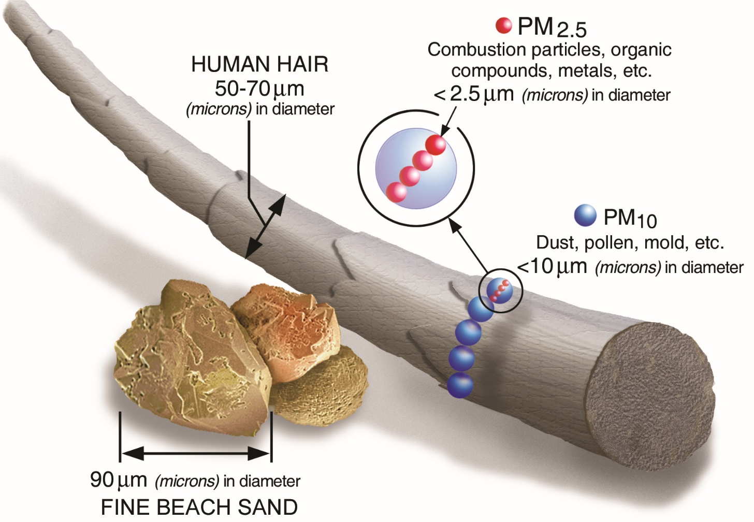
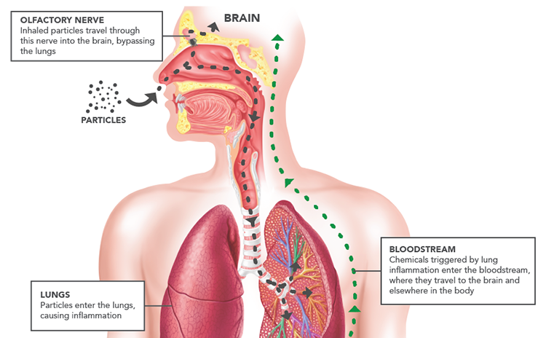
The health effects of pollution are large…
More than 6.6 million deaths attributable to air pollution worldwide in 2019
(12% of total deaths)
26%
Stroke
20%
Ischemic heart disease
20%
Neonatal disorders
19%
Lung cancer
CPAT air pollution module
Notes:
https://www.epa.gov/pm-pollution/particulate-matter-pm-basics

Slide 42
From Emissions to Health Impacts
Air-Pollution Module • Method
CPAT follows a five-step chain. Each step uses established science to turn emissions into a number of deaths and a money value.
1. Emissions
→
2. Concentration
→
3. Exposure–response
→
4. Disease burden
→
5. Valuation
Inputs that shape the result
Population and age groups • diseases (heart, lung, stroke, diabetes, lower-respiratory) • weather and geography • income and value of statistical life (VSL).

Slide 43
Air Pollution Model Overview
ENERGY CONSUMPTION
EMISSIONS TO CONCENTRATION MODELS
EMISSION FACTORS
CONCENTRATIONS
(PM2.5, O3)
EMISSIONS
(PM AND OTHERS)
COPD
DM T2
LRI
LUNG C
IHD
STROKE
LBW
EXPOSURE-RESPONSE
  Diseases
  Model
Neonates
Under 15
15 to 24
25 to 65
65+
  Age groups
Ambient PM2.5
Household PM2.5
Ground-level Ozone
  Health risks
TOTAL DISEASE BURDEN
GDP, VSL, wages, etc.
BURDEN OF DISEASE ATTRIBUTED TO POLLUTION
VALUE OF AP EXTERNALITIES
  Main outputs
HEALTH IMPACTS
(DEATHS, DALYs)
ECONOMIC INDICATORS
  Input/Output
  Model
  Flow

Slide 44
Two Sources of Pollution, One Health Cost
Air-Pollution Module • Sources & Value
OAP — Outdoor (ambient)
Pollution from power plants, industry, and transport in the open air. Concentration depends on emissions, weather, and terrain.
HAP — Household
Indoor pollution from solid fuels used for cooking and heating. People can be exposed to both at once.
Putting a value on the benefit
Value of avoided deaths = Avoided deaths × Value of Statistical Life (VSL)
VSL is adjusted by each country's income. Result: lives saved and their economic value under the policy.

Slide 45
Air Pollution Q&A
Air-Pollution Module
Methodology
Emissions → concentration → exposure-response → disease burden → valuation.
Population split into age groups; risks applied to each.
Household pollution (HAP) tied to solid fuels for cooking and heating.
Outdoor pollution (OAP) from power, industry and transport.
Value of avoided deaths = avoided deaths × income-adjusted VSL.
Outputs: attributable deaths and DALYs (years of healthy life lost).
Health impacts use the Global Burden of Disease (GBD) framework.
Both outdoor (ambient) & indoor (household) pollution covered.
Updating from GBD 2019 toward the GBD 2021 study.
Q. Why include health in a climate tool?
A. Cutting fuel use lowers pollution and saves lives — often a large, near-term local benefit.
Q. Which pollutants matter most?
A. Fine particles (PM2.5) and ground-level ozone (O₃) drive most health damage.
Q. Are the benefits local or global?
Mostly local and immediate, unlike climate benefits which are global and long-term.
Q. How do emissions become concentrations?
A. Through 'intake fraction' or other methods that account for weather and geography.
Q. What is an exposure–response function?
A. Links level of a pollutant to extra risk of a given disease.
Q. Which diseases are included?
A. Heart disease, stroke, lung cancer, COPD, lower-respiratory infection, diabetes, and birth effects.
Q. What is VSL?
Value of Statistical Life — a standard money value placed on reducing the risk of death. Willingness to pay for risk reduction rises with income; VSL is scaled accordingly.
Settings & dashboard
Co-benefit results appear in the Air-Pollution output graphs.
Avoided deaths shown alongside total welfare effects.
VSL assumptions set on the air-pollution parameters tab.
Welfare value reported per tonne and in total.
Data sources
GBD 2019 (IHME) • WHO • Vollset et al. (2020)

Slide 46
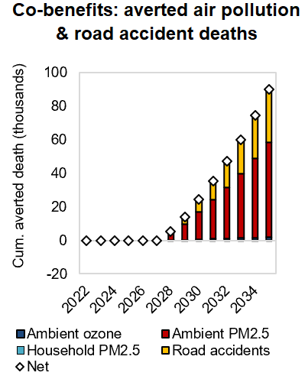
Modelled Results: Air Pollution Co-benefits
Code | Policy Bundle | Air pollution deaths avoided (number of deaths) | % of total annual air pollution deaths
 | Policy Bundle Options - Carbon Pricing (modelled)
1A | Comprehensive carbon levy: upstream carbon price on all fossil fuel consumption + downstream emissions in CBAM sectors only + recycling to public investment | 1656 | 2.0%
2A | Carbon levy on all fossil fuel consumption (upstream carbon price) + recycling to public investment | 1564 | 1.9%
2B | Carbon levy on all fossil fuel consumption (upstream carbon price) + recycling to households | 1631 | 2.0%
3A | Downstream carbon price on heavy industry + recycling to households | 546 | 0.7%
3B | Downstream carbon price on heavy industry + output-based rebating (OBR) for CBAM producers | 213 | 0.3%

Slide 47
Methodology
Overview
Mitigation (Energy Use, Revenues, Emissions)
Distribution
Air Pollution
Transport and GDP
47

Slide 48
Other Co-Benefits: Transport & GDP
Other Modules • Transport & GDP • Module 4
Two more modules complete the picture: road transport co-benefits, and the effect of raising and spending revenue on GDP.
Transport Module
Higher fuel prices reduce vehicle-kilometres travelled (VKT). Less driving means fewer road accidents and deaths, less urban congestion, and less road damage.
Carbon tax
→
fuel price
→
VKT
→
fewer externalities
Revenue & GDP
Carbon pricing raises revenue. How that money is used decides the effect on GDP.
GDP effect = shock × multiplier (public investment gives the largest long-term gain)

Slide 49
Other Co-Benefits: Transport & GDP
Other Modules • Transport & GDP • Backup / Advanced
Q & A
Q. How does fuel price affect driving?
A. Higher prices reduce vehicle-kilometres travelled (VKT), well documented in the literature.
Q. What is a fiscal multiplier?
A. The % change in GDP from a fiscal change worth 1% of GDP, over up to 10 years.
Q. Which revenue use helps GDP most?
A. Public investment gives the largest long-term gain.
Methodology
Transport: lower VKT → fewer accidents, less congestion, less road damage.
Multipliers estimated by local-projection panel methods (Jordà et al.).
GDP effect = fiscal shock × country-specific multiplier.
Settings & dashboard
Choose multiplier source: income-group, global, manual, or estimated.
GDP assumptions shown on dashboard row ~180.
Data sources
MFMod (World Bank) • Schoder (2022) • transport-economics literature

Slide 50
HOW TO USE CPAT

Slide 51
How to Use CPAT
Getting Set Up:
  Accessing/Requirements
Using CPAT
  Running basic scenarios
51

Slide 52
Accessing CPAT & Excel Requirements
You can request CPAT from the World Bank
For country applications we provide a single-country version (for example, Egypt) which has smaller file size
You will need a recent version of Excel (desktop version)
CPAT is a large file and so you should not have too many other applications open
Basic CPAT does not require macros but more advanced versions do
There is a multi-scenario tool available for advanced use (report writing)

Slide 53
How to Use CPAT
Getting Set Up:
  Accessing/Requirements
Using CPAT
  Navigating and Running basic scenarios
Egypt-Specific Exercises
53

Slide 54

Using CPAT
The basics are simple:
  Design your policy
  View the output graphs
  Copy them into your reports or presentations
For more systematic use a ‘quick start’ guide is also available, this is also available as the first section of our online documentation

Slide 55
CPAT Dashboard
Policy design
Policy Strength, Assumptions
Core Outputs
Prices
Navigation

Slide 56
CPAT Dashboard
Policy design
Policy Strength, Assumptions
Core Outputs
Prices
Navigation

Slide 57
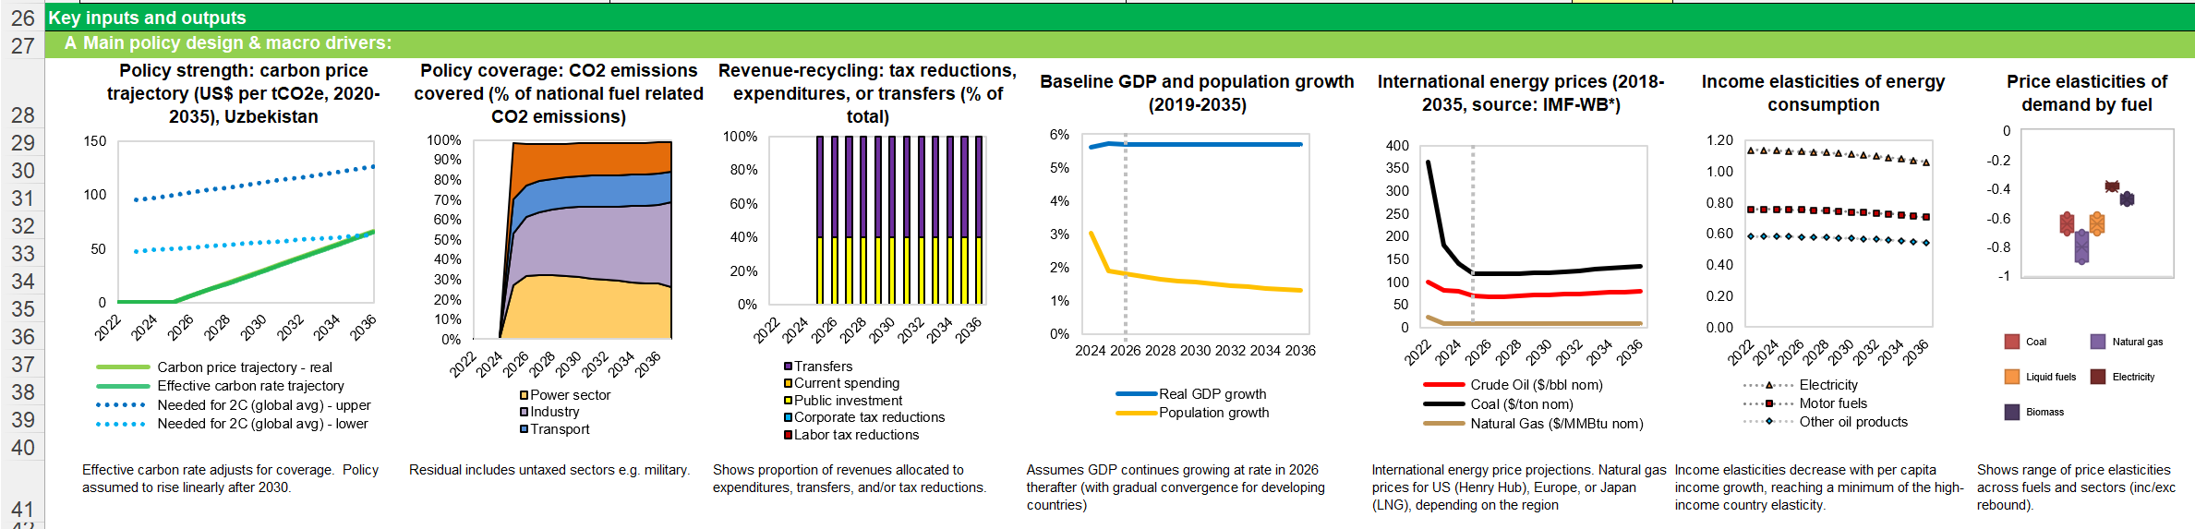
Policy Strength & Assumptions
  Carbon Price
  Coverage
  Rev. Use
  GDP, Population Assumptions
  Energy
  Prices
  Elasticities
57

Slide 58
CPAT Dashboard
Policy design
Policy Strength, Assumptions
Core Outputs
More Detail, starting with Prices
Navigation

Slide 59
Output Graphs
  Session 2 (next)
  Emissions
  Fiscal Revenues
  GDP
  Session 3
  Impacts on Households
  Co-benefits (avoided deaths)
  Total $ welfare effects

Slide 60
CPAT Dashboard
Policy design
Policy Strength, Assumptions
There are a lot of graphs and settings organized by module (Mitigation incl Power, Air Pollution, Distribution, Transport)
They are there just to help.
Core Outputs
More Detail, starting with Prices
Navigation

Slide 61
CPAT Dashboard
Policy design
Policy Strength, Assumptions
Core Outputs
More Detail, starting with Prices
Navigation

Slide 62
Navigating CPAT
You can navigate around CPAT by clicking different tabs. There are three overarching tabs: Cover, Dashboard (the main tab), Manual Inputs (User Inputs).
After the four main modules of CPAT (mitigation, distribution, air pollution and transport), code readable inputs and outputs of CPAT are presented in MTinput and MTOutput tabs, followed by various data sources driving CPAT, ordered by tab.
Input Data
GDP (see inputs): Modifiable in Manual Inputs
Domestic Prices and Taxes: See Prices_dom
Output Data
MTOutputs
Mitigation / Distribution / Air pollution / Transport

Slide 63
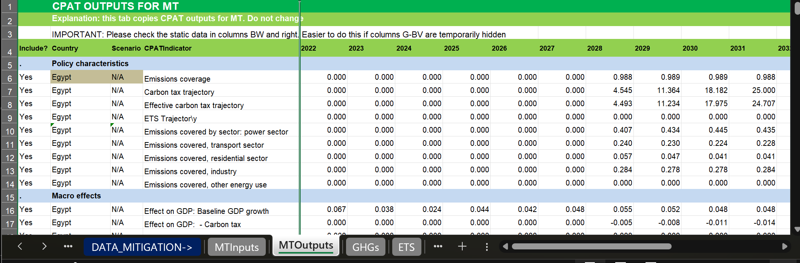
Output Data
See MTOutputs and bottom of Mitigation (AP/Transport/Distn) tabs
Retail price, taxes and supply costs measured in USD/GJ
Subsidies measured negative price.

Slide 64
EXERCISE

Slide 65
How to Use CPAT
Getting Set Up:
Using CPAT
Exercises
Input Assumptions, Output Data
Policy Scenarios
Results
65

Slide 66
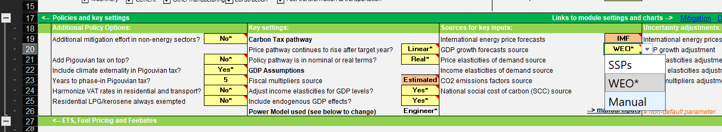
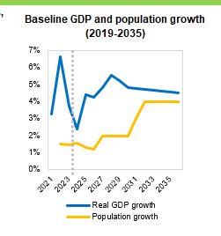
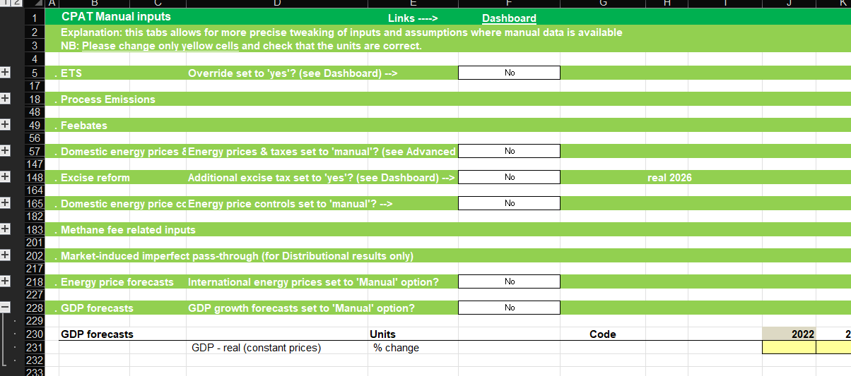
Tailoring GDP Assumptions
Default is in dashboard, source can be changed here

Slide 67
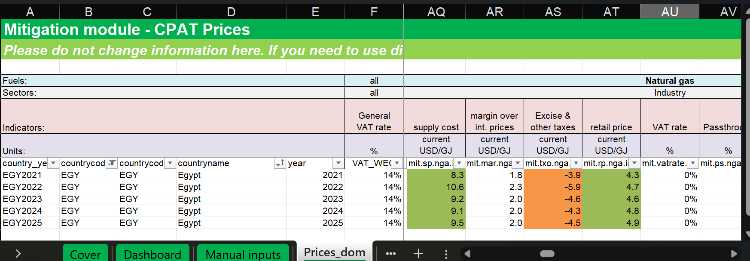
Tailoring Prices and Taxes
Please go to Prices_Dom for domestic prices and taxes.
Retail price, taxes and supply costs measured in USD/GJ
Subsidies measured negative price.

Slide 68
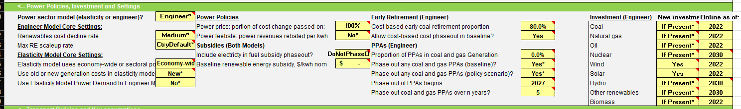
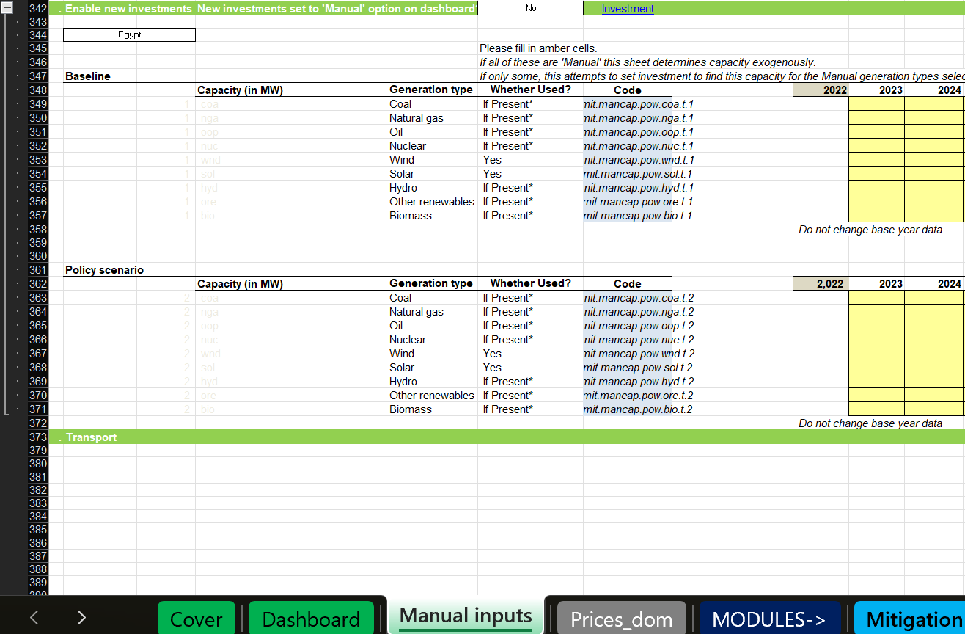
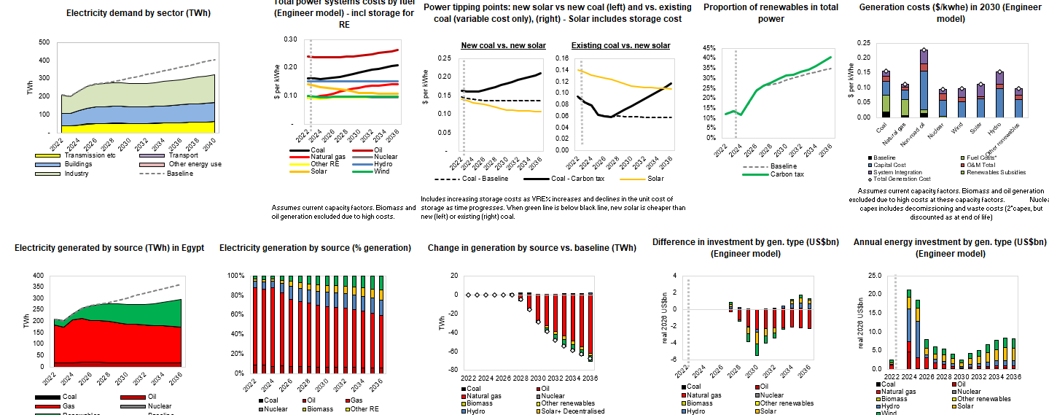
Tailoring Power Sector & Electricity Results
Dashboard: Expandable Tab
Manual Inputs: Specific Power Capacity Increases
Dashboard: Power Sector Outputs

Slide 69
Exercises
Please create a presentation for one of the four policies below
Policy 1: $5 carbon tax in 2028 rising to $20 in 2030.
Policy 2: $5 carbon tax in 2028 rising to $20 in 2030. Industry sectors (Iron and Steel, Cement, Chemicals, Other Metals)
Policy 3: Increase in Natural Gas Prices in Residential Sector of $2/GJ by 2030
Policy 4: elimination of price controls and consumer subsidies (5 years)
50% of revenues in public investment; 50% of revenues into per-capita transfers to bottom 40%;
For each, four slides, with description
Revenues
Emissions Reductions
Co-benefits (Cumulative air pollution deaths)
Impact on households (relative consumption share)

Slide 70
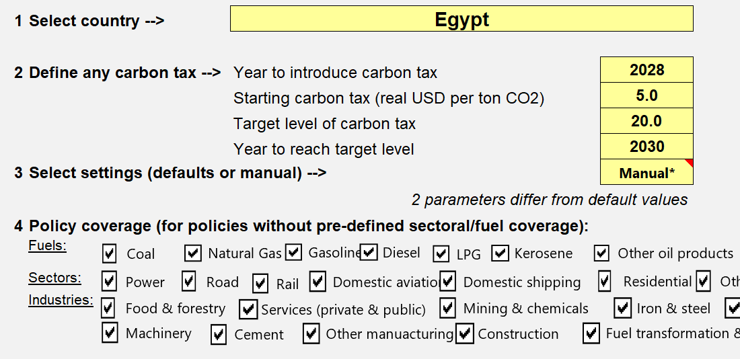
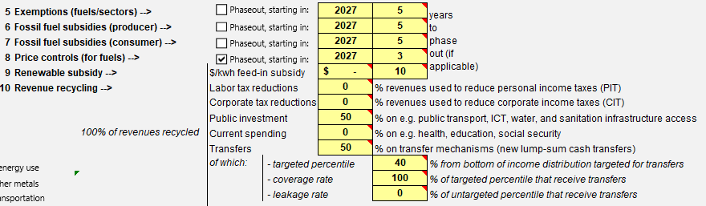
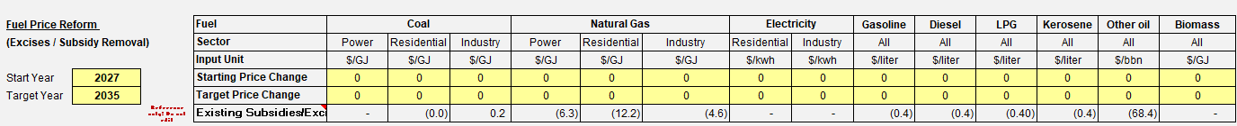
Core Policy Options
Carbon Tax (Left); Price Control Reform & Revenue Use (Right), Specific Fuel Price Reform(Bottom)

Slide 71
Policy 1
Carbon Tax (Left);
Policy 1: $5 carbon tax in 2028 rising to $20 in 2030.

Slide 72
Policy 2
Carbon Tax (Left);
Policy 2: $5 carbon tax in 2028 rising to $20 in 2030. Industry sectors (Iron and Steel, Cement, Chemicals, Other Metals)

Slide 73
Policy 3
Specific Fuel Price Reform(Bottom)
Policy 3: Increase in Natural Gas Prices in Residential Sector of $2/GJ by 2030

Slide 74
Policy 4
Price Control Reform & Revenue Use (Right)
Policy 4: elimination of price controls and consumer subsidies (5 years)

Slide 75
Exercises
Please create a presentation for one of the four policies below
Policy 1: $5 carbon tax in 2028 rising to $20 in 2030.
Policy 2: $5 carbon tax in 2028 rising to $20 in 2030. Industry sectors (Iron and Steel, Cement, Chemicals, Other Metals)
Policy 3: Increase in Natural Gas Prices in Residential Sector of $2/GJ by 2030
Policy 4: elimination of price controls and consumer subsidies (5 years)
50% of revenues in public investment; 50% of revenues into per-capita transfers to bottom 40%;
For each, four slides, with description
Revenues
Emissions Reductions
Co-benefits (Cumulative air pollution deaths)
Impact on households (relative consumption share)

Slide 76
All Policy Options
Revenue Use (Right),

Slide 77
Core Policy Options
Carbon Tax (Left); Price Control Reform & Revenue Use (Right), Specific Fuel Price Reform(Bottom)

Slide 78
Exercises
Please create a presentation for one of the four policies below
Policy 1: $5 carbon tax in 2028 rising to $20 in 2030.
Policy 2: $5 carbon tax in 2028 rising to $20 in 2030. Industry sectors (Iron and Steel, Cement, Chemicals, Other Metals)
Policy 3: Increase in Natural Gas Prices in Residential Sector of $2/GJ by 2030
Policy 4: elimination of price controls and consumer subsidies (5 years)
50% of revenues in public investment; 50% of revenues into per-capita transfers to bottom 40%;
For each, four slides, with description
Revenues
Emissions Reductions
Co-benefits (Cumulative air pollution deaths)
Impact on households (relative consumption share)

Slide 79
Output Graphs
  Emissions
  Fiscal Revenues
  GDP
  Impacts on Households
  Co-benefits (avoided deaths)
  Total $ welfare effects

Slide 80
Output Graphs
  Emissions
  Fiscal Revenues
  GDP
  Impacts on Households
  Co-benefits (avoided deaths)
  Total $ welfare effects

Slide 81
Exercises
Please create a presentation for one of the four policies below
Policy 1: $5 carbon tax in 2027 rising to $20 in 2030.
Policy 2: $5 carbon tax in 2027 rising to $20 in 2030. Industry sectors (Iron and Steel, Cement, Chemicals, Other Metals)
Policy 3: Increase in Natural Gas Prices in Residential Sector of $2/GJ by 2030
Policy 4: elimination of price controls and consumer subsidies (5 years)
50% of revenues in public investment; 50% of revenues into per-capita transfers to bottom 40%;
For each, four slides, with description
Revenues
Emissions Reductions
Co-benefits (Cumulative air pollution deaths)
Impact on households (relative consumption share)

Slide 82
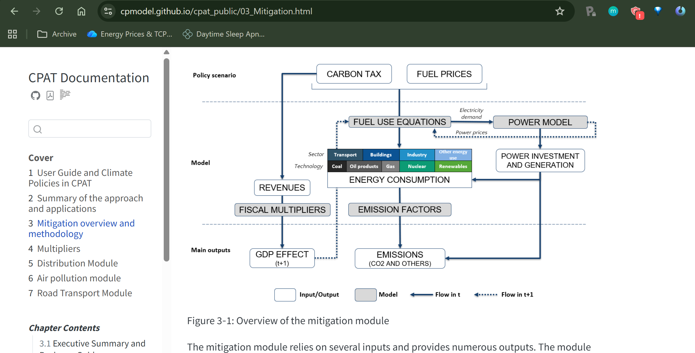
More Information
https://cpmodel.github.io/cpat_public/

Slide 83


Thank you for your attention!
External WB Website:
https://www.worldbank.org/en/topic/climatechange/brief/climate-policy-assessment-tool (or google "CPAT WB")
Internal: http://cpat/
Online documentation:
https://cpmodel.github.io/cpat_public/
Questions/to request CPAT, email: cpat@worldbank.org

